Slide 1
CAREER COMPANION
IBM AICTE PROJECT
Presented By: Sarthak Nikose
College Name & Department : Priyadarshini College Of Engineering ( 2025 passed Out ) - Electronics and Telecommunications

Slide 2
OUTLINE
Problem Statement
Technology used
Wow factor
End users
Result
Conclusion
Git-hub Link
Future scope
IBM Certifications

Slide 3
Problem Statement
Students often face difficulty making informed career decisions due to fragmented access to guidance, limited awareness of personal strengths, and rapidly evolving job markets. Traditional counseling systems lack personalization, scalability, and real-time adaptability — leading to mismatches in career paths, underutilized potential, and future regret.
Proposed Solution: The Carrier Companion will use Natural Language Processing (NLP) to address the lack of personalized and scalable career guidance that autonomously supports students in making informed, future-ready career decisions with much ease.

Slide 4
Technology used
IBM cloud lite services
Natural Language Processing (NLP)
Retrieval Augmented Generation (RAG)
IBM Granite model

Slide 5
IBM cloud services used
IBM Cloud Watsonx AI Studio
IBM Cloud Watsonx AI runtime
IBM Cloud Agent Lab
IBM Granite foundation model

Slide 6
Wow factors
The AI-powered career counseling agent stands out by delivering real-time, personalized guidance tailored to each student's strengths, interests, and academic data.
Unique Features :
Offers multiple tailored career paths like “Safe”, “High-Growth”, and “Bold” options.
Shows 3–5 year career projections including roles, effort level, skills, and ROI.
Ensures fair, supportive suggestions regardless of background or career choice.

Slide 7
End users
College/University Students
Educational Institutions and Universities
Teachers and Mentors
EdTech Platforms

Slide 8
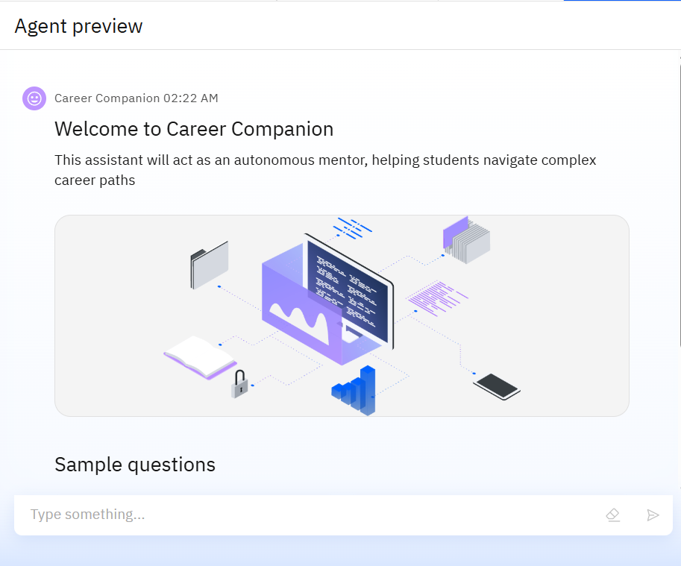
Results

Slide 9
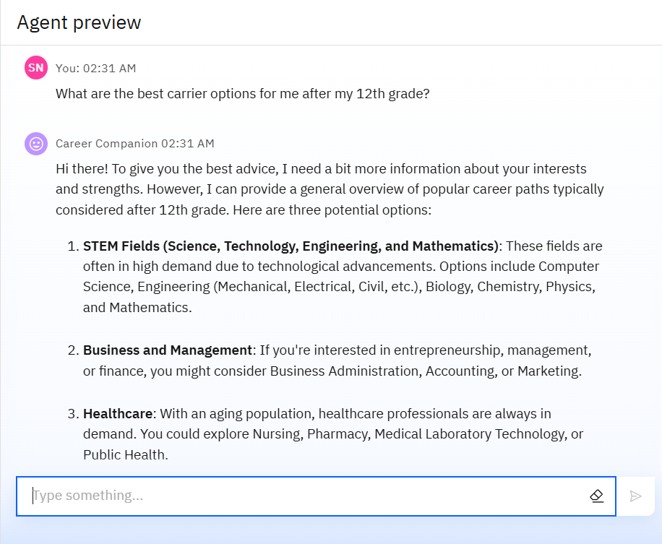
Results
Tracks changes in performance and adjusts recommendations in real time—no manual intervention needed.
Supports traditional, emerging, and unconventional careers with structured advice and inspiration.
Providing solutions based on carrier related querries making it popular among young masses.

Slide 10
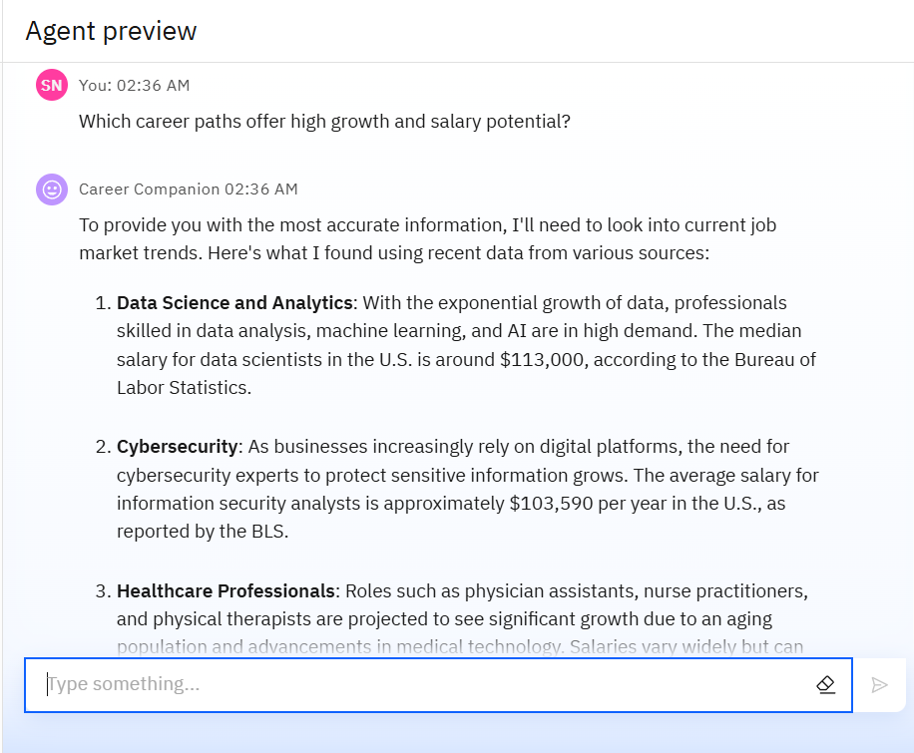
Results
Encourages strengths, suggests alternative routes when needed, and reduces confusion through supportive guidance.
Using AI-driven insights, it offers scenario-based recommendations, highlights industry-aligned skills, and provides actionable learning goals.

Slide 11
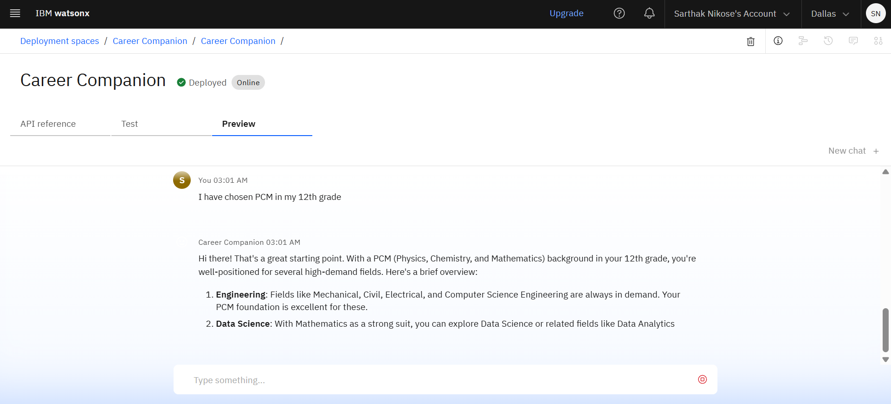
Results
Deployed Career Companion AI Agent

Slide 12
Conclusion
The Career Companion AI revolutionizes traditional career counseling by offering personalized, adaptive, and data-driven guidance.
It empowers students to make informed, confident decisions aligned with their strengths, goals, and market trends.
This agent is not just a tool — it’s a smart companion for every learner’s journey to success.

Slide 13
GitHub Link
Github Link:

Slide 14
Future scope
Integration with Real-Time Job Market APIs
Enhanced Personalization with Emotional AI
Predictive Success Modeling
Collaboration with Industry Mentors & Recruiters
Integration with Learning Platforms

Slide 15
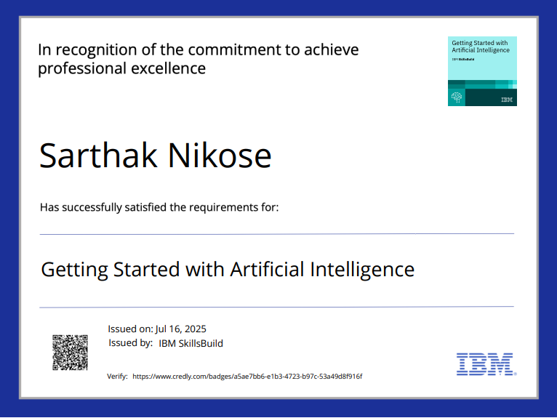
IBM Certifications

Slide 16
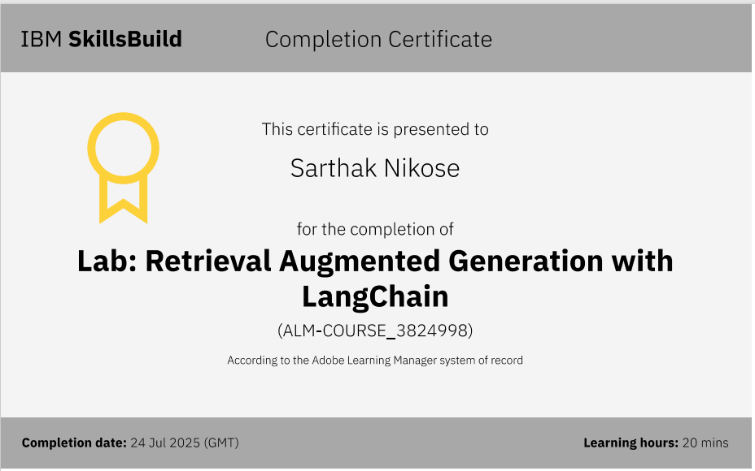

Slide 17
THANK YOU

